Slide 1
SlideLizard Quiz Templates

Slide 2
Do you want your audience to interactively participate in the quiz with their smartphones?
With SlideLizard‘s PowerPoint-Plugin you can simply transform the following Quiz templates into interactive Live-Quizzes! You can even show the results directly in your slides!
Download now for free: https://slidelizard.com/en/download

Slide 3
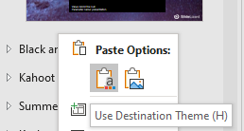
Instructions
Look for your desired quiz template in the sections on the left
Select the slides. (Press CTRL & then click on all the slides you want in your presentation.) Then right click > Copy
Open the presentation that you want your quiz to be in.
Right click in the slide overview on the left, then click Paste and Use Destination Theme.
Activate SlideLizard and let your audience paticipate https://help.slidelizard.com/d/connect-your-presentation-to-slidelizard/
RECOMMENDED

Slide 4
PowerPoint Quiz Template Galaxy Quiz

Slide 5
What is your question?
Number of votes
0
Time left
-
Answer A
Answer B
Answer C
Answer D

Slide 6
What is your question?
Number of votes
0
Time left
-
Poll results are shown here if you use SlideLizard

Slide 7
PowerPoint Quiz Template
Basic Black & White

Slide 8
Number of votes
0
Time left
-
Answer A
What’s your question?
Answer B

Slide 9
What’s your question?
Answer A
Answer B
Number of votes
0
Time left
-

Slide 10
What’s your question?
Answer A
Answer B
Number of votes
0
Time left
-

Slide 11
PowerPoint Quiz Template
Kahoot

Slide 12
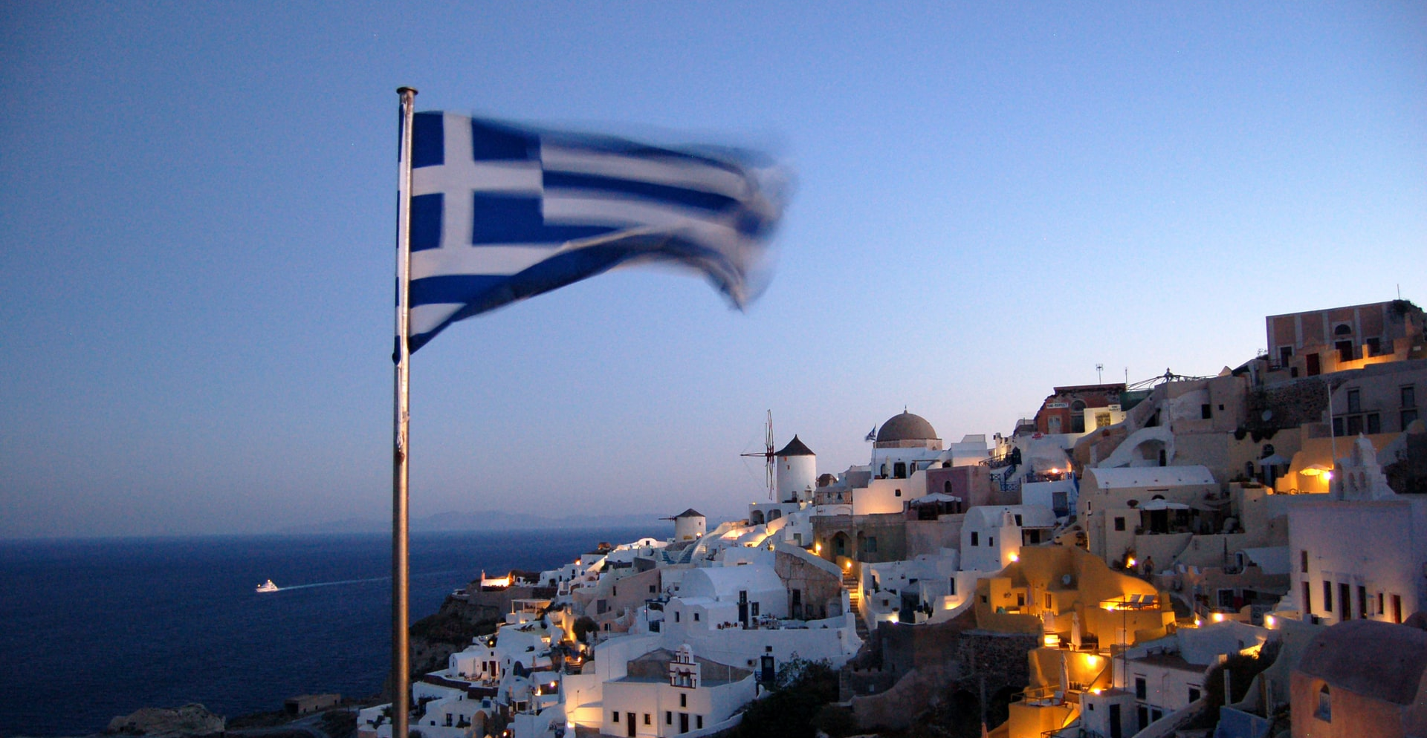
Name this country:
0
-
Answers
Greece
Canada
Italy
Turkey

Slide 13
Name this country:
Poll results are shown here if you use SlideLizard
0
-
Answers
Greece
Canada
Italy
Turkey

Slide 14
PowerPoint Quiz Template
Summer Breeze

Slide 15
What is your question?
Answer A
A
Answer B
B
Answer C
C
Answer D
D

Slide 16
What is your question?
Poll results are shown here if you use SlideLizard

Slide 17
What is your question?
Answer A
A
Answer B
B
Answer C
C
Answer D
D

Slide 18
PowerPoint Quiz Template
Keyboard Yes/No Quiz
(with Escape possibility)

Slide 19
Your Yes/No question…
Yes
Yes

Slide 20
Your Yes/No question…
Yes
No
Escapeo

Slide 21
Your Yes/No question…
Poll results are shown here if you use SlideLizard

Slide 22
Personality Quiz
PowerPoint Quiz Template

Slide 23
What is your question?
Answer A
Answer B
Answer C
Answer D

Slide 24
Get SlideLizard to see your poll result right here
https://slidelizard.com/download

Slide 25
PowerPoint Quiz Template Picture Quiz

Slide 26
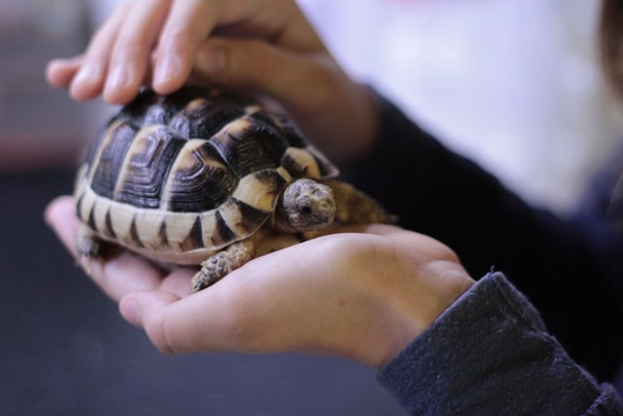
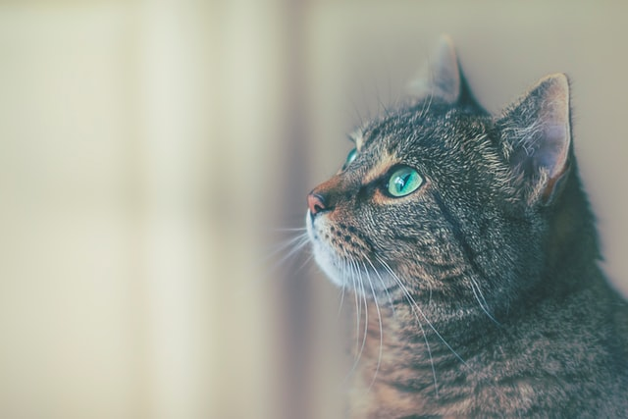
Which of these pictures show mammals?
A
B
C
D

Slide 27
PowerPoint Quiz Template
Minimalist Quiz.

Slide 28
What is your question?
a.
Answer A
b.
Answer B
c.
Answer C
d.
Answer D
e.
Answer E

Slide 29
True or false?
True.
False.

Slide 30
Get SlideLizard to see your poll result right here.

Slide 31
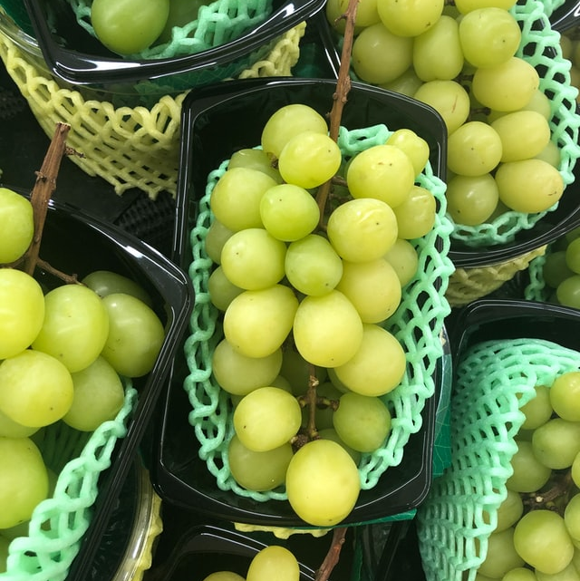
PowerPoint Quiz Template
Vocabulary Quiz
los zapatos
to sing
la manzana
cantar
shoes
la camisa
bailar
to dance
las uvas
shirt

Slide 32
Click on a card to see the correct answer!
to sing
la manzana
el gato
cantar
the cat
la camisa
shirt
bailar
to dance
las uvas

Slide 33
TUTORIAL
Step 1 – Drag the blue cards off the green ones

Slide 34
TUTORIAL
Step 2 – Change the text in the green and blue boxes to your desired words or change the images
Step 3 – Drag the blue boxes over the green ones again
Step 4 – In presentation mode, click on a card once your students gave an answer to reveal the correct word

