Slide 2
Germany
The capital of Germany is Berlin with 3.6 million inhabitants. Berlin is also the country's largest city and at the same time a federal state. The Federal Republic of Germany is a parliamentary democracy.

Slide 3
Austria
The capital of Austria is Vienna, the smallest province in the country in terms of area, but the most populous. The famous zoo "Tiergarten Schönbrunn" is the oldest zoo in the world still in operation, since 1752.
Lower Austria
Vienna
Upper Austria
Vorarlberg
Burgenland
Salzburg
Styria
Tirol
Carinthia

Slide 4
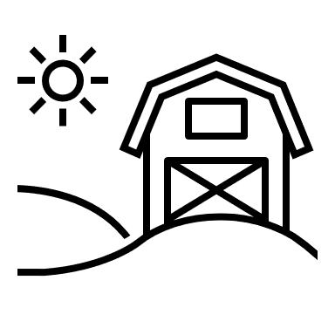
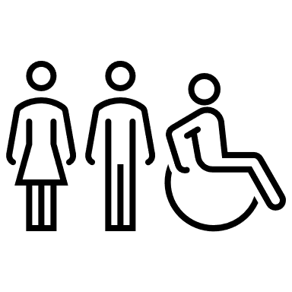
Switzerland
26 cantons: "member states“
20 full cantons & 6 half-cantons
4 official languages:
German 63.5% French 22.5%
Italian 8.1% Rhaeto-Romanic 0.5%
8 million people:
average age is rising -> fewer children, but people are getting older
Very sustainable:
very good recycling system
2/3 renewable energies (hydropower)
Law: 30% of the country is forested

Slide 5
Spain
Spain is the EU's second largest city, covering 505,955 square kilometers.
The peninsula also has the second highest number of bars per inhabitant in the world. There are 44 UNESCO World Heritage Sites.

Slide 6
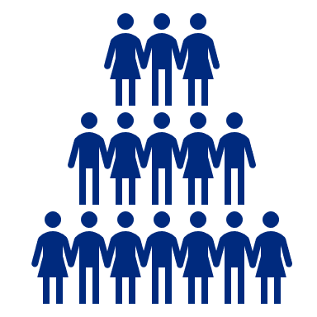
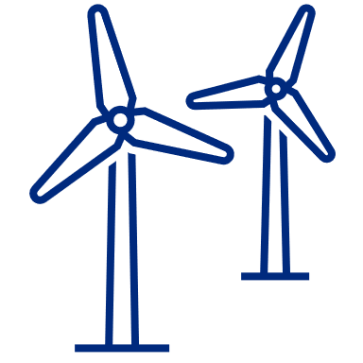
Europe
448 mill.
- 21%
EU- Population
EU- Greenhouse gases
(since 1990)
73%
1 billion
EU- Employment rate
EU- Passengers
+ 1,5%
1/3
EU- Economic growth
Women in the EU- Research

Slide 7
China
Area: 9.6 million km² (almost the same as Europe)
Religions: Buddhism, Daoism, Christianity, non-denominational
Almost ¼ of the world population lives in China
Written language has about 80,000 characters

Slide 8
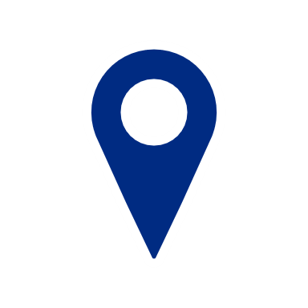
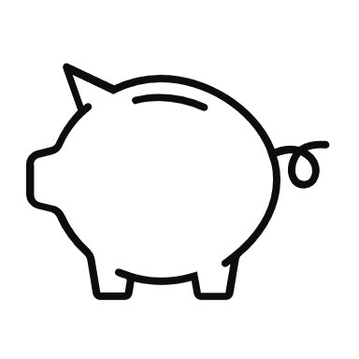
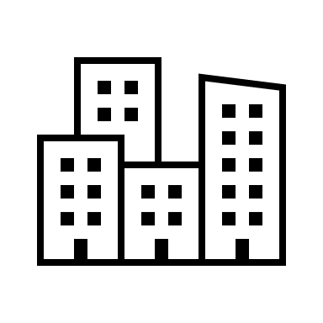
Afrika
Algeria the largest country in Africa
Nigeria the richest country in Africa BDP = 398,19 $
South Africa has 3 capitals: Cape Town, Pretoria, Bloemfontein

Slide 9
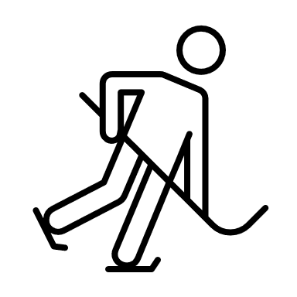
North America
Possible decline in National Hockey League (NHL) sales per home game due to corona pandemic
* In 1,000 US dollars
* Status March 2020

Slide 10
United States of America
New York
Was the capital of the USA (1789 - 1790)
Nevada
Famous city: Las Vegas
Many ski resorts and casinos
Texas
Everything slightly larger than normal
Known for: Cowboys, oil fields, cattle herds

Slide 11
Australien
Northern Territory
Smallest continent
6- largest country on earth
Longest coral reef and largest ecosystem: Great Barrier Reef
The name "Australia" comes from the Latin "australis" = "south”
Queensland
Western Australia
South
Australia
New South Wales
Sydney
…largest city
Victoria
…capital
Canberra
Tasmania

Slide 12
Facts about the world
World population
Gender distribution
Most popular destinations by number of international visitors 2019 (in millions)
1.
5.
3,82
ITALY
2.
FRANCE
64,7
90,2
SPAIN
* numbers in billions
83,7
3,89
3.
4.
USA
CHINA
78,7
67,6

Slide 13
Editable world map

