Slide 1

Bad Presentations
Common mistakes you should avoid

Slide 2

Colors in presentations
wrong
not too colorful
many colors → not serious
emphasize important information
contrast background and font

Slide 3


Colors in presentations
right
not too colorful
many colors → not serious
emphasize important information
contrast background and font

Slide 4
Too minimalistic design
wrong
don‘t be too minimalistic
don‘t use blank slides
is boring
looks lazy
make it simple but serious

Slide 5

Too minimalistic design
right
don‘t be too minimalistic
don‘t use blank slides
is boring
looks lazy
make it simple but serious

Slide 6
Common mistakes in presentations
wrong
In presentations you should not avoid eye contact with your audience
You should never speak incoherently and you should not speak too fast. Avoid this by taking short pauses to collect yourself.
You should not use too many colors in your presentation because it doesn‘t look serious
Avoid too many text on your presentation and never write entire sentences
You should not use images as a background because the text will be difficult to read then
You should speak free instead of reading aloud
You should not read the text from the slides because your audience can read for themselves

Slide 7
Common mistakes in presentations
right
Avoid eye contact
Speaking incoherently
Too many colors
Too much text
Images as background

Slide 8







IMAGES
wrong
illustrate something
add variety
too many can distract
fit content

Slide 9
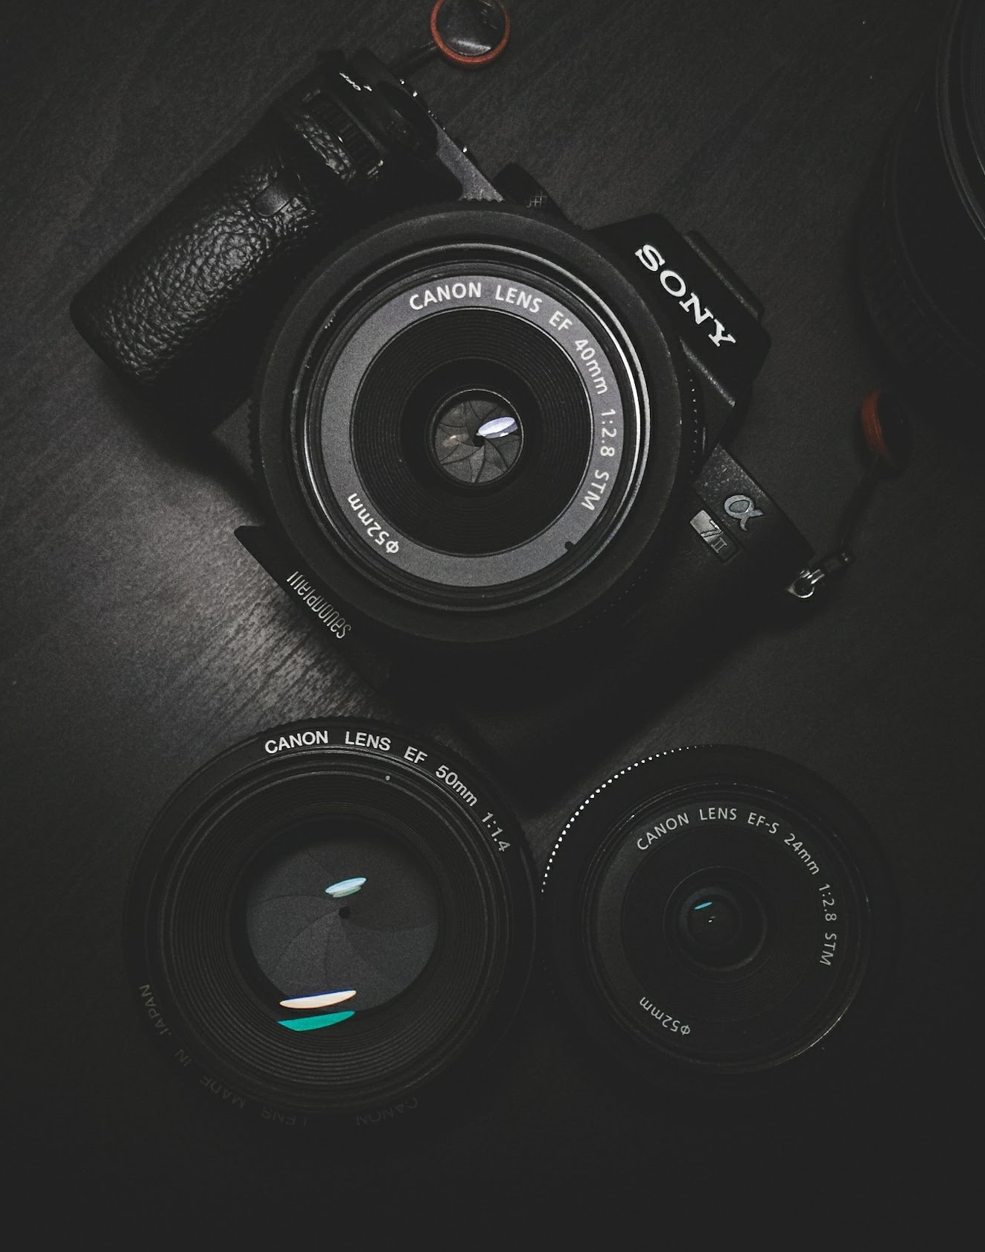
Images
right
illustrate something
add variety
too many can distract
fit content

Slide 10
Fonts
wrong
many different fonts look messy
max. 2 different fonts
legible at long distances
Script,, italic and decorative fonts → slow to read
should be avoided

Slide 11
Fonts
right
many different fonts look messy
max. 2 different fonts
legible at long distances
script, italic and decorative fonts → slow to read
should be avoided

Slide 12
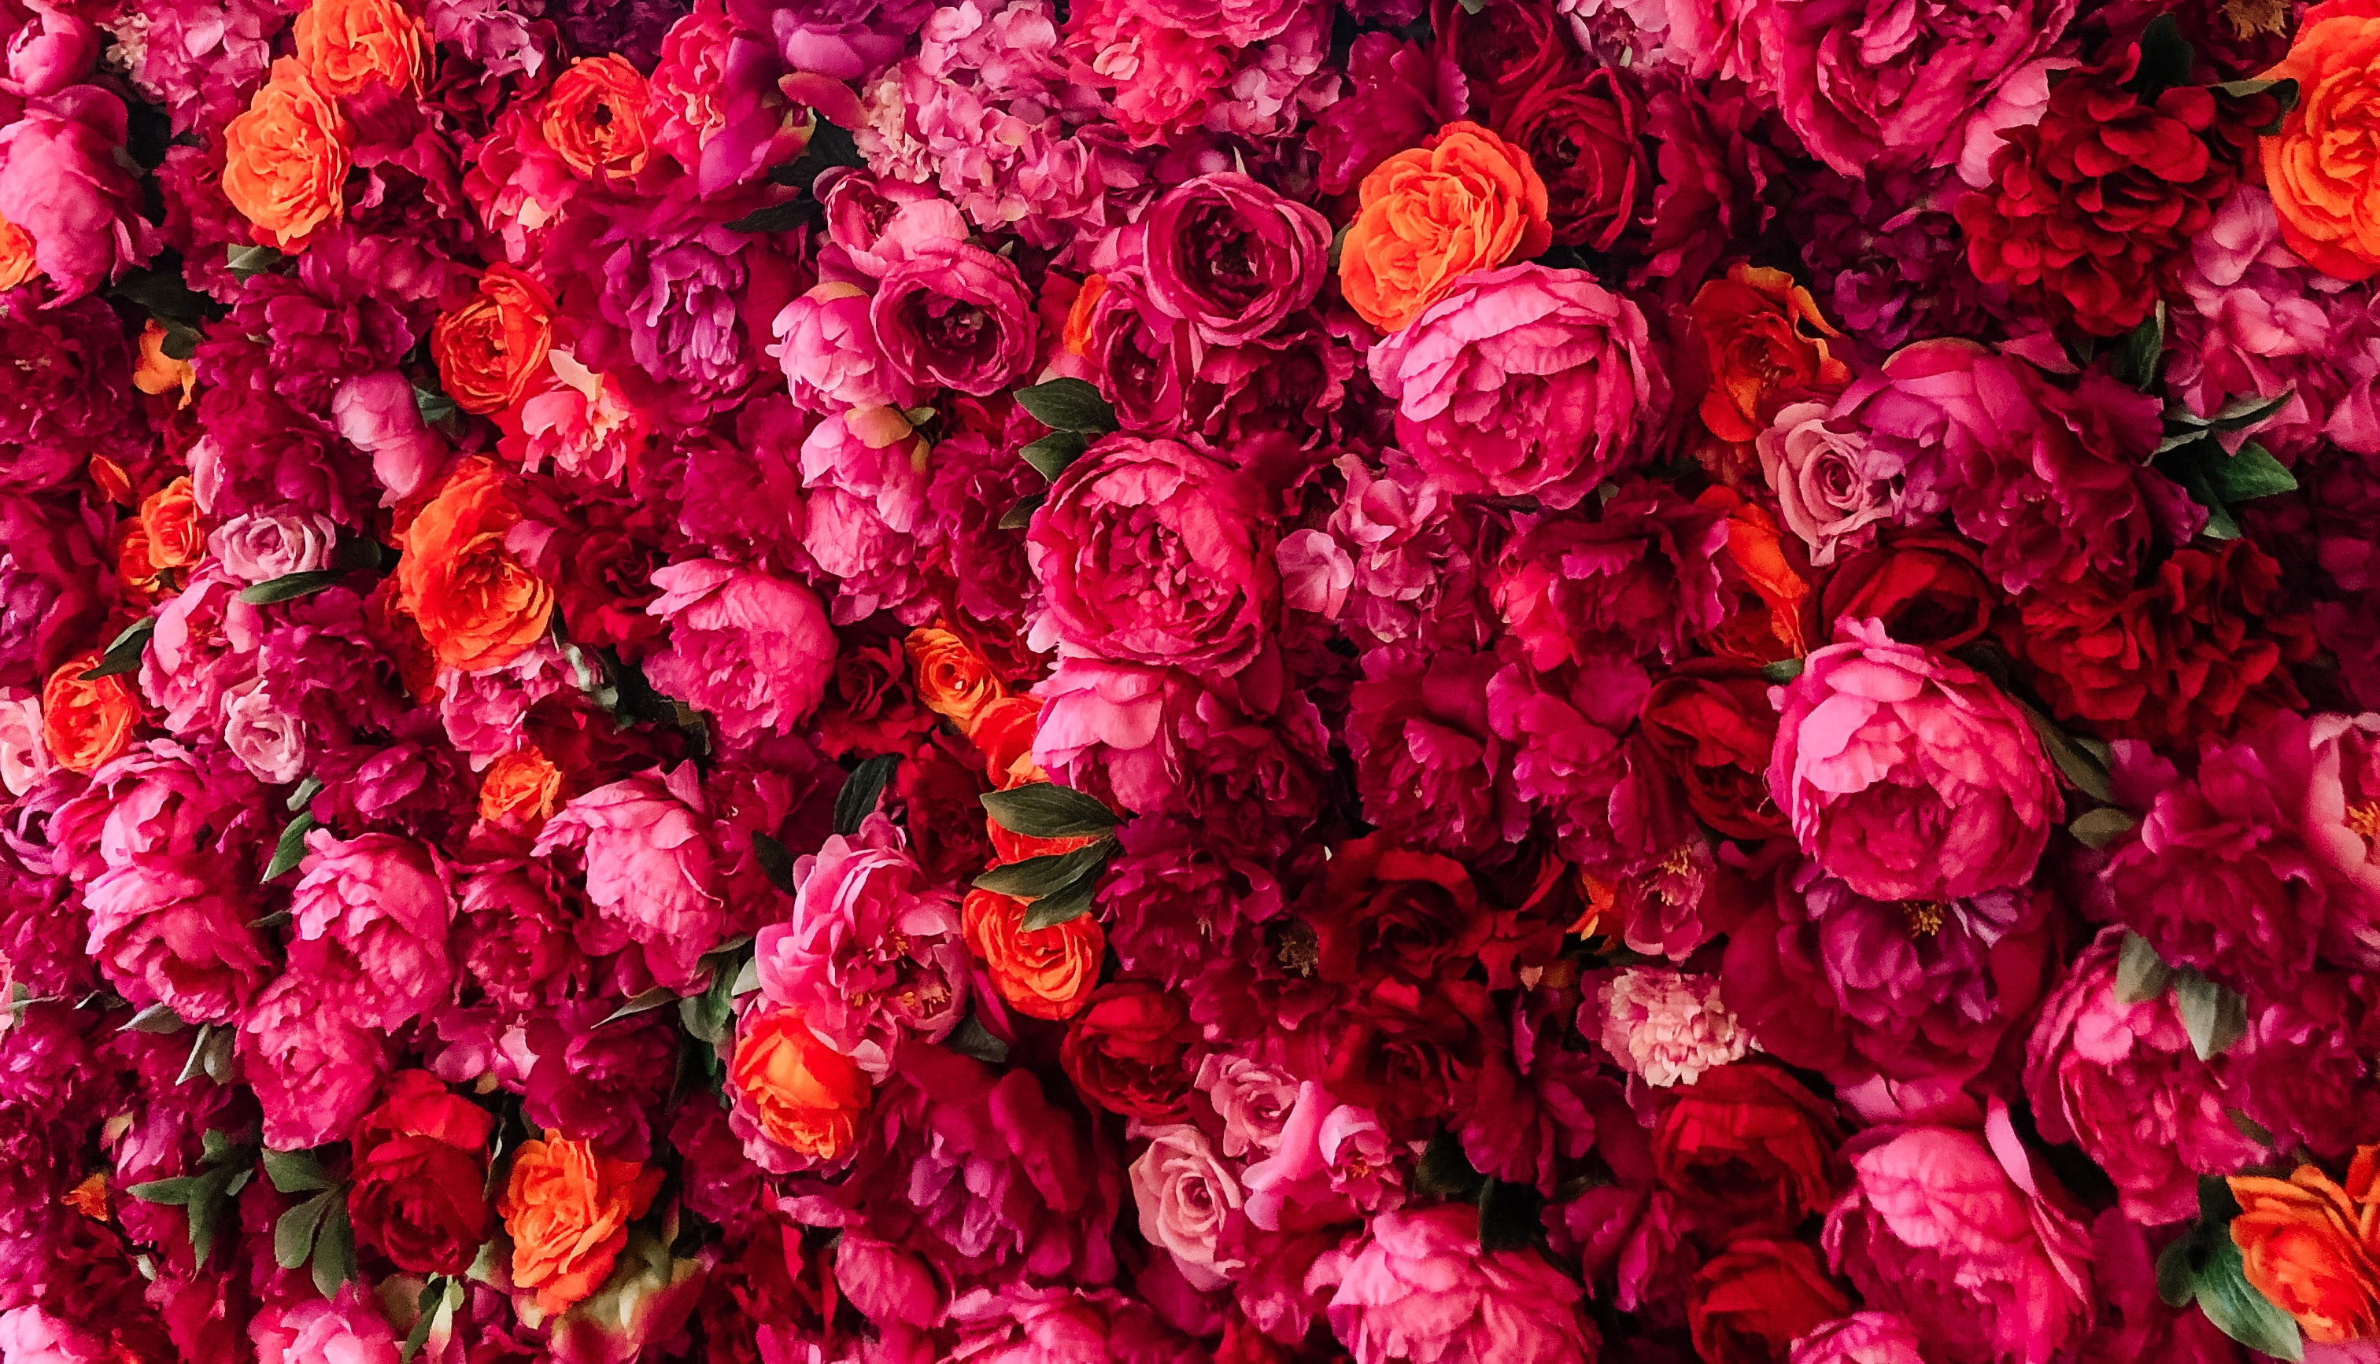
Images as background
wrong
don‘t use images as background
difficult to read text
distracts from text
not much contrast
looks messy

Slide 13

Images as background
right
don‘t use images as background
difficult to read text
distracts from text
not much contrast
looks messy

Slide 14

Images as background
wrong
don‘t use images as background
difficult to read text
distracts from text
not much contrast
looks messy

Slide 15
Images as background
right
don‘t use images as background
difficult to read text
distracts from text
not much contrast
looks messy

